Slide 1
AI-Powered Resume & Cover Letter Generator
Created by- UDITI VERMA
Roll Number-2300271530131
Class- CSE(AIML)-2

Slide 2
Overview
This project includes two AI-powered applications built with Streamlit:
1. Cover Letter Generator (cover_letter_app.py)
2. Resume Generator (project.py)
Both apps leverage Google Gemini AI to generate professional documents.

Slide 3
What is Streamlit?
Open-source Python framework for building interactive web apps
Designed for data science and AI projects
Easy UI creation with forms, inputs, and visualizations
Ideal for rapid prototyping and deployment

Slide 4
What is GenAI?
- Short for Generative AI (e.g., Gemini, GPT)
- Generates human-like text, images, or code
- Learns from prompts and user inputs
- Powers intelligent, context-aware content creation

Slide 5
Resume Generator
Built with Streamlit and Gemini AI
Generates resumes with structured sections:
- Summary
- Skills
- Education
- Experience
- Objective
Exports to PDF with clean formatting
Simple user interface for data entry

Slide 6
Cover Letter Generator
Built with Streamlit and Gemini AI
Generates professional cover letters
Customizable tone (Professional, Friendly, Formal, etc.)
User inputs personal details, job title, company, and skills
Outputs styled cover letter (PDF & TXT downloads)

Slide 7
Streamlit in Resume & Cover Letter Generator
- Provides user interface for input forms
- Accepts candidate details (Name, Education, Experience, Skills)
- Displays generated resume and cover letter
- Allows download in PDF/Word formats

Slide 8
GenAI in Resume & Cover Letter Generator
- Processes user inputs via structured prompts
- Creates professional resumes tailored to job roles
- Generates personalized cover letters
- Ensures context-aware highlighting of relevant skills

Slide 9
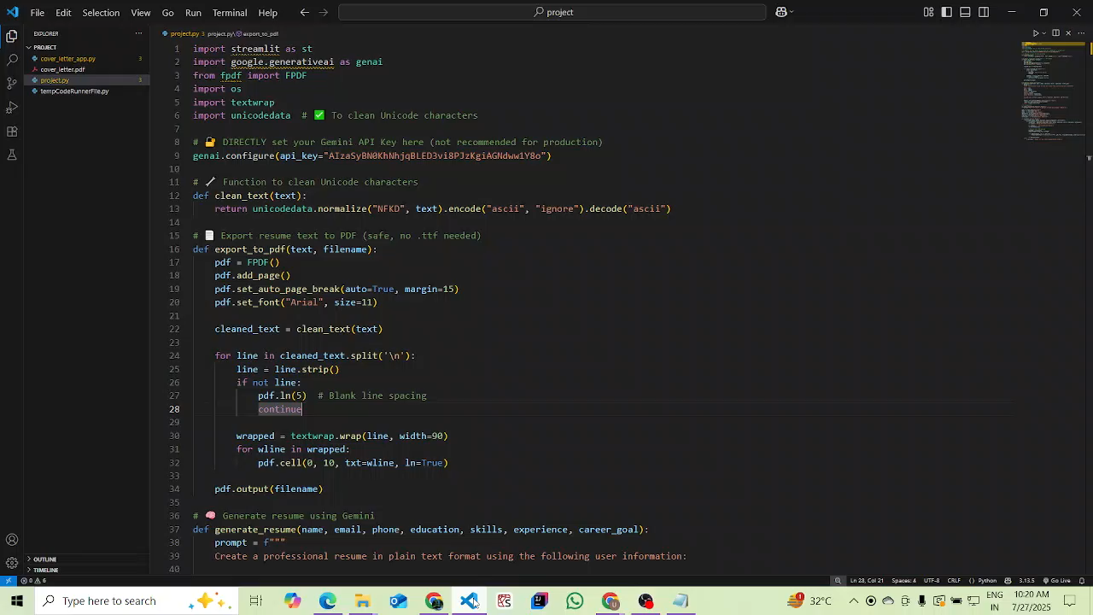
VIDEO

Slide 10
Benefits of the Project
Saves time for job seekers by auto-generating documents
Provides professional, well-structured outputs
Flexible and customizable
Easy to use web interface
Download options for both PDF and text formats

Slide 11
Conclusion
This project demonstrates how AI can be leveraged to create professional job application documents.
By integrating Gemini AI with Streamlit, we enable users to generate resumes and cover letters quickly, effectively, and with professional quality.

Slide 12
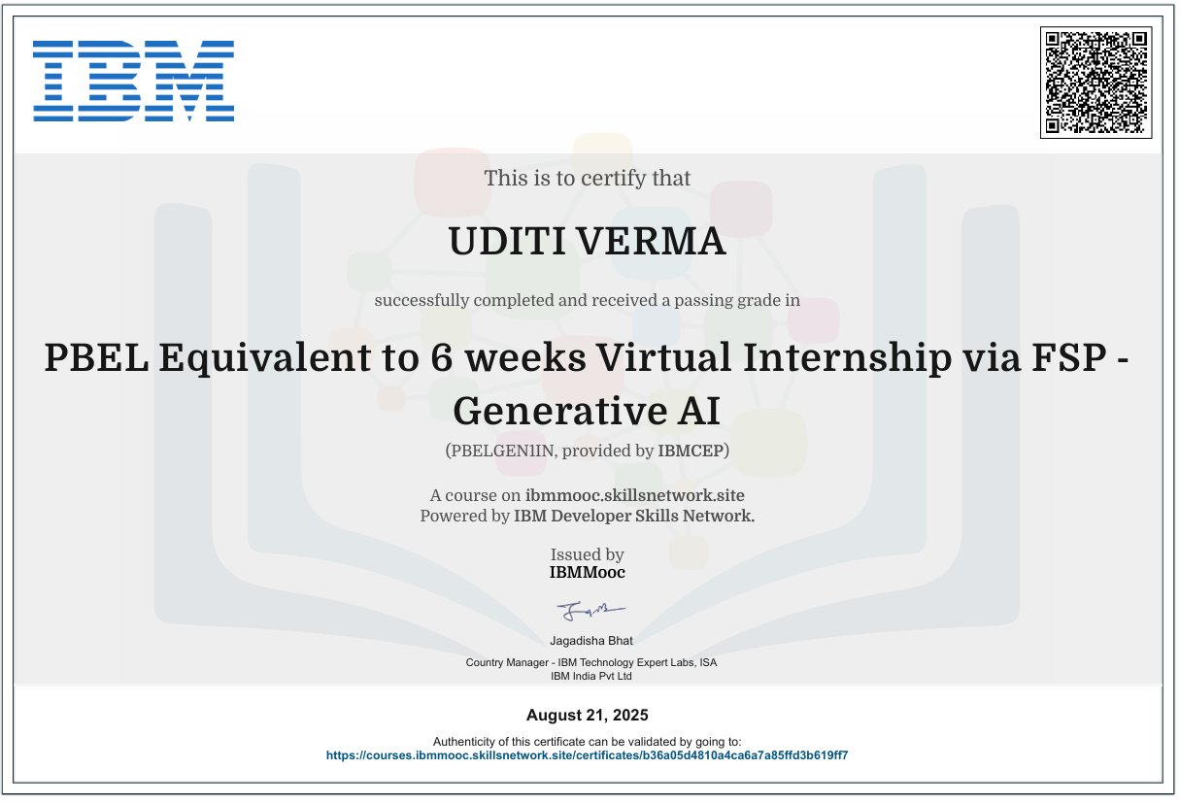
CERTIFICATE

Slide 13
THANK YOU!

